Slide 1

Predictive modeling in practice

Slide 2
Getting data
Implement in production
Data due diligence
Make business case,
present value
Data cleaning
Model comparison
Model 1
Model 2
Model N
Predictive modeling
Notes:
Predictive modeling:
Dependent measure
predictors

Slide 3
Regression vs classification
Regression: metrics like RMSE and R 2
Classification: expected value, ROC curve
We will focus on binary classification, for which the classes often are simply called 'positive' and 'negative'

Slide 4
Model selection
Very complex topic, we’ll do the bare minimum
Comparing different parameter sets in a single model is easier than comparing across models

Slide 5
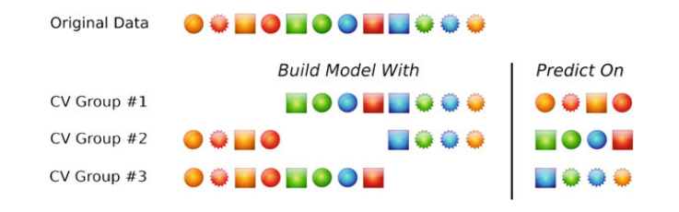
How to measure performance in a model: crossvalidation

Slide 6
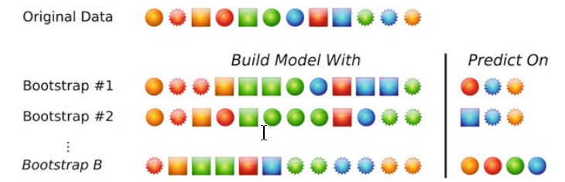
How to measure performance in a model: Boostrap

Slide 7
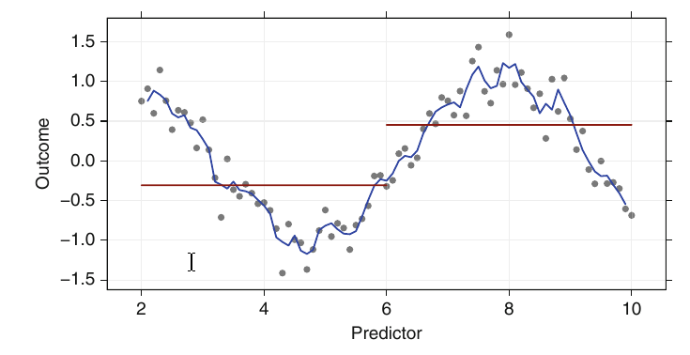
Over-fit, variance/bias dilemma
Notes:
Don’t worry, this will be explained by Mikio/Konstantinos

Slide 8
f(X)
Changing μ shifts the distribution left or right.
Changing σ increases or decreases the spread.
σ
μ
X

Slide 9
This is a bell shaped curve with different centers and spreads depending on μ and σ
Note constants:
π=3.14159
e=2.71828

Slide 10
Separability

Slide 25
ROC curves
This may be a good time to explain ROC curves, but it derails the explanation on separability that leads to understanding SVMs

Slide 26
Support Vector machines
And Kernel methods

Slide 27
What is an SVM?
SVMs introduced in COLT-92 by Boser, Guyon & Vapnik. Became rather popular since.
SVM is one of several Kernel methods
The objective of a SVM is to find the optimal separating hyperplane
It does this by defining a kernel and a margin. Basically the margin is a no man's land. There will never be any data point inside the margin.
The optimal hyperplane will be the one with the biggest margin.

Slide 28
What is a metric?
Distance metrics are functions d(a, b) such that d(a, b) < d(a, c) if objects a and b are considered 'more similar' than objects a and c. Two objects exactly alike would have a distance of zero. One of the most popular examples is Euclidean distance. To be a ‘true’ metric, it must obey the following four conditions:

Slide 29
What is a metric?
1. d(a, b) >= 0, for all a and b
2. d(a, b) == 0, if and only if a = b, positive definiteness
3. d(a, b) == d(b, a), symmetry
4. d(a, c) <= d(a, b) + d(b, c), the triangle inequality

Slide 30
What is a Kernel?
A kernel is essentially a mapping function - one that transforms a given space into some other (usually very high dimensional) space.
A kernel is a distance.

Slide 31
Hyperplane
An hyperplane is a generalization of a plane.
In one dimension, an hyperplane is called a point
In two dimensions, it is a line
In three dimensions, it is a plane
In more dimensions you can call it an hyperplane

Slide 32
Dot product
The dot product, x_{i} u, can be written as a product of the distance of x_{i} from the origin, the distance of u from the origin, and the cosine of the angle between x_{i} and u (Dillon and Goldstein 1984).

Slide 33

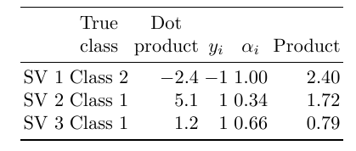
Predictor X2
-4 -2 0 2 4
-4 -2 0 2 4
Predictor X1

Slide 34
Predictor X2
-4 -2 0 2 4
-4 -2 0 2 4
Predictor X1

Slide 35
Predictor X2
-4 -2 0 2 4
-4 -2 0 2 4
Predictor X1

Slide 36
Kernels

Slide 37
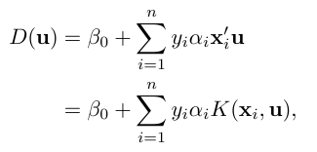
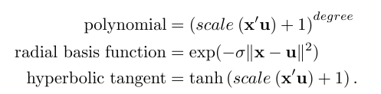

Slide 38
Parameters

Slide 39
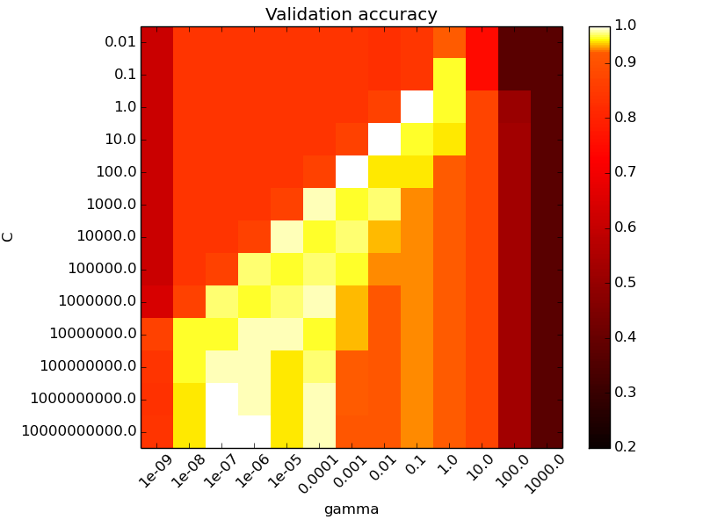

Slide 40
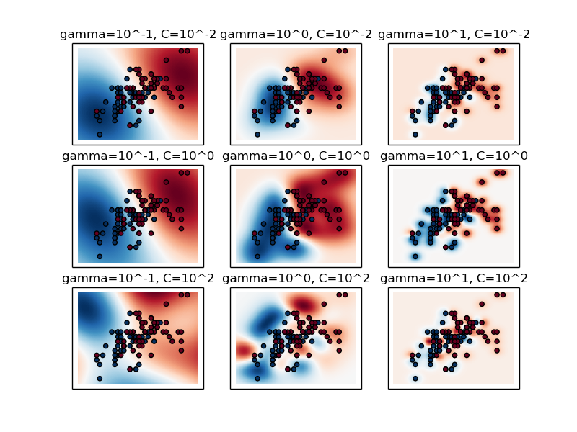
http://scikit-learn.org/stable/auto_examples/svm/plot_rbf_parameters.html

Slide 45
Lets try to go into another space, where separability is higher
In this simple example, we just change the axis, but in real SVM applications we go into a higher dimensional space. Those are hard to visualize. So we stick to another 2D projection

Slide 50
Support vectors
In SVM only the poorly predicted points define the line. The points that have good predictions are ignored.

Slide 51
Maximum margin
In SVM only the poorly predicted points define the line. The points that have good predictions are ignored.

Slide 52
margin

Slide 53
Support vectors

Slide 54
S₄
S₅
Support vectors
S₂
S₃
S₁
S₈
S₇
S₆

Slide 55
Cost function

Slide 56
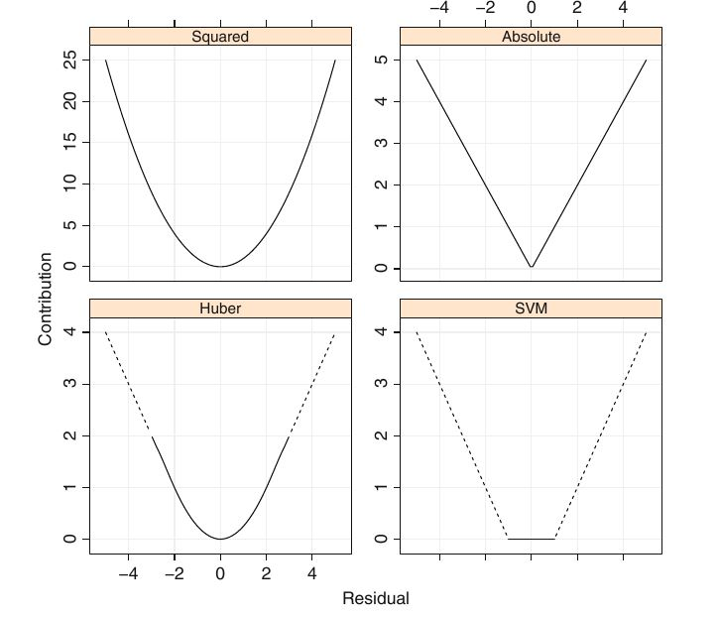
Notes:
This is for regression (top left)

Slide 60
The kernel trick
Moving to a higher dimensional space actually helps

Slide 61
Going up in dimensionality
As it turns out, it is much easier and efficient to find out boundaries which are in the form of a straight line (or an analogous construct in higher dimensions called hyper plane) compared to curvy boundaries.
The number of support vectors is the dimensionality of the new space

Slide 62
<x, y>
Original space

Slide 63
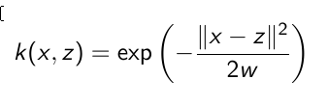
<x, y>
kernel
Original space

Slide 64
<x, y>
<k(x), k(y)> → k(x,y) → <S₁, S₂ , S₃, S₄, S₅, S₆, S₇, S₈>
kernel
Original space
Feature space

Slide 65
Dealing with non-numerical attributes
1- If you are sure the categorical attribute is actually ordinal, then just treat it as numerical attribute.
2- If not, use some coding trick to turn it into numerical attribute.

Slide 66
Advantages
Can do regression and classification
Computationally efficient
Easy to interpret
Fast in prediction
Low generalization error
Works with both numerical and categorical attributes

Slide 67
Disadvantages
Sensitive to tuning parameters and kernel choice
Designed for binary (non-probabilistic) classification

